Slide 1
Lecture 3
553.283: Introduction to R

Slide 2
4.2: Data Frames and Lists
  Multivariate data consists of multiple data vectors considered as a whole. We’re free to work with our data as separate variables, but it can behoove us to combine related vectors into a single object such as a data frame, which is used to store a rectangular grid of data.
    Usually, rows correspond to experimental units/subjects, and columns correspond to variables/measurements.
    All column lengths are the same.
  A list is a more general storage object which is comprised of a collection of components
    Size of the objects can differ.
    Anything goes in terms of structure!

Slide 3
4.2: Examples of Both
Data frame: Any one of the various data sets we’ve used throughout these lectures. E.g., lynx, babies, iris.
List: Typically the output of a function. E.g., consider the object
  Dhf = density(iris$Sepal.length)
  We can check that Dhf is a list via summary(Dhf), which tells us each component and gives its data type.

Slide 4
4.2.1: Creating a Data Frame or List
Data frames are created with data.frame(). E.g.,
  x=1:2; y=letters[1:2]; z=1:3
  data.frame(x,y)
  data.frame(x,y,z) #error due to unequal lengths
Lists are created with list(). E.g.,
  list(x,y,z) #unnamed components
  list(x.name=x,y.name=y,z.name=z) #named components

Slide 5
4.2.2: Accessing Values in a Data Frame
Can access values with either the name of a column or with row column notation
  DF = data.frame(x,y)
  DF$x #access x column of DF
  DF$[,’x’] #access column named x
  DF$x[1] #access first entry in column x of DF
  DF[1,2] # access entry in first row, second column

Slide 6
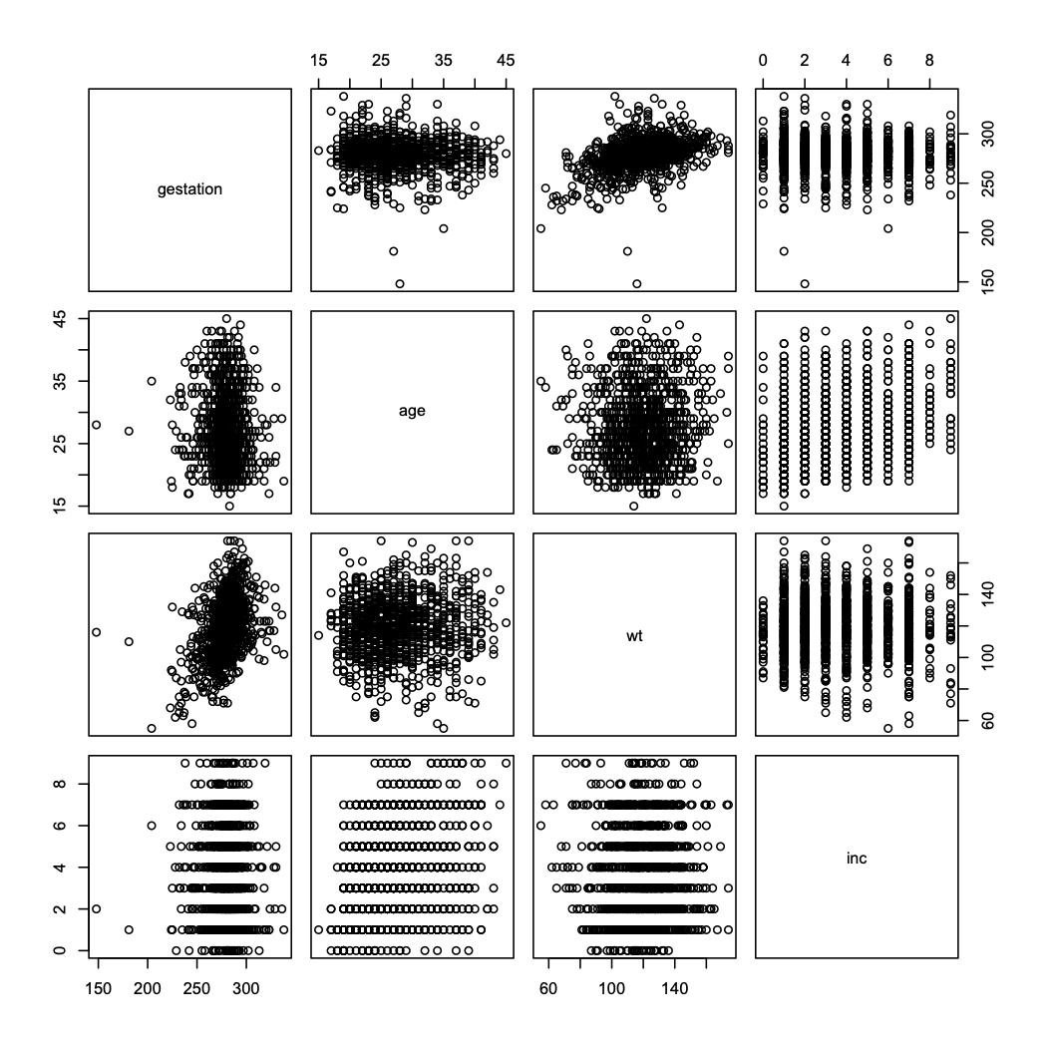
Ex: Using data-frame notation to simplify tasks
Data-frame notation allows us to take subsets of the data frames in a straightforward manner. Consider the babies dataset again; we’ll check if any relationships appear between gestation, wt, age, and inc using pairs().
Again, we need to avoid NA values for all of these. Inspection reveals that NA codes for gestation, age, and inc are 999, 99, and 98, respectively.
In our plot construction we’ll omit any observations for which any of those variables is NA.
  attach(babies)
  not.these = (gestation==999) | (age==99) |(inc==98)
  TMP = babies[!not.these,
  c(‘gestation’,’age’, ‘wt’,’inc’)]
  pairs(TMP)
  detach(babies)

Slide 7
4.2.2 cont: Accessing values in a list
If list components are unnamed, use double-bracket notation [[]].
  lst = list(x,y,z)
  lst[[1]] #access first component x
If components are named, access using $comp.name.
  lst.named = list(x.name=x,
  y.name=y, z.name=z)
  lst.named$x.name
  names(lst.named)
  lst.named[['x.name']]
For both data frames and lists, can edit values or components by accessing them and reassigning them, or using edit(obj).

Slide 8
Extended Tangent on dplyr and ggplot2
553.283 Intro to R

Slide 9
Tidyverse
The tidyverse collection is a set of R packages designed to mitigate various issues (mainly relating to organization) that may arise when using R for data science.
dplyr package: contains tools to efficiently, easily manipulate data frames
ggplot2 package: contains tools to efficiently, easily create attractive plots
Go ahead and install tidyverse, and load it into the workspace using library()

Slide 10
dplyr and Tibbles
dplyr Contstrains options, helps one think about data manipulation challenges.
Provides simple “verbs”, functions that correspond to common data manipulation tasks
Works efficiently and quickly
Utilizes objects known as tibbles, which can be thought of as modernized data frames
E.g., flights (nycflights13) is saved as a tibble object
To convert a data frame to a tibble, use as_tibble()

Slide 11
Single Table Verbs
Dplyr aims to provide a function for each basic task of data manipulation.
As in base R, all the output of all of these functions can be stored as an object in the workspace.
filter() | Select cases based on their values
arrange() | Reorder based on values of a variable
select() and rename() | Select variables based on their names.
mutate() and transmute() | Add new variables that are functions of existing variables.
summarise() | Condense multiple values to a single value
sample_n() and sample_frac() | Take random samples.

Slide 12

Data: nycflights13
We’ll explore all this through the example of the flights (nycflights13) data set, which contains info on all 336,776 flights that departed from NYC in 2013.
Install the package.
  library(nycflights13)
  flights #inspect data set
This data set is already a tibble, but if we have a data frame df that we want to convert to a tibble named tib, we use tib=as_tibble(df).

Slide 13
filter()
filter() allows us to select a subset of a tibble. The first argument is the tibble object, and the subsequent arguments are logical expressions for the data, separated by commas.
The function returns all data for which all logical statements are TRUE.
E.g., select all flights on January 1st:
  filter(flights, month==1,day==1)
Roughly equivalent to R-base code:
  flights[flights$month==1 & flights$day==1]
When using dplyr functions, do not need to use attach() or $ notation.

Slide 14
arrange()
arrange() works similarly to filter(), except that it reorders rows according to the ordering of one or more particular variables instead of subsetting them.
First argument is the tibble, the second argument is the reordering variable, and subsequent arguments are variables that break ties of the variable immediately preceding them.
E.g., sort by scheduled departure time (sched_dep_time), using departure delay (dep_delay) to break ties:
  arrange(flights, sched_dep_time, dep_delay)
Use desc() on one of the reordering variables to sort by descending order of that variable:
  arrange(flights, desc(sched_dep_time), dep_delay)
Can reorder by as many varaibles as you like!

Slide 15
select() and rename()
select() allows us to subset the data by selecting the columns/variables that we’re interested in. As before, the first argument is the tibble, and the subsequent arguments are the variables we wish to select.
E.g., selecting only date-related variables (year, month, day):
  select(flights, year, month, day)
  select(flights, year:day) #select all variables between year and day, inclusive
E.g., selecting all variables except date-related variables:
  select(flights,-(year:day))

Slide 16
select() and rename(), cont.
Can also use select() to rename variables. Syntax is select(tibble, new.name = oldname).
E.g., variable name tailnum doesn’t match style of other variable names, so change it to match style:
  select(flights, tail_num = tailnum)
However, doing this produces a tibble with only the variable in question and drops the rest. Function rename() renames variables without dropping the rest. Syntax is the same:
  rename(flights, tail_num = tailnum)

Slide 17
mutate() and transmute()
mutate() adds new columns that are functions of existing columns. Syntax is
  mutate(tibble, new_var = func_old_vars)
E.g., add gain variable that gives amount of time exceeding scheduled time in the air, and speed variable in mph:
  mutate(flights,
  gain = arr_delay - dep_delay,
  speed = distance/air_time * 60)
Supsequent new variables in the same command can refer to previous new variables created.
If you only want to keep the new variables use transmute() with the same syntax.

Slide 18
summarise()
Collapses data frames to a single row. Syntax is summarise(tibble, entry_name=function)
E.g., determine mean and standard deviation of departure delay (dep_delay):
  summarise(flights,
  mean_dep_delay = mean(dep_delay, na.rm=T),
  sd_dep_delay = sd(dep_delay, na.rm=T))
This is kinda useless until we touch upon the group_by() function.

Slide 19
group_by()
Groups data set into multiple subsets. Syntax is group_by(tibble, grouping_var).
The resulting tibble includes the grouping variable in the tibble heading with the number of groups.
E.g., group flights data by tail number (tailnum):
  by_tailnum = group_by(flights, tailnum)
Using summarise() on a saved group_by() tibble summarizes by group:
  summarise(by_tailnum,
  mean_dep_delay = mean(dep_delay, na.rm=T),
  sd_dep_delay = sd(dep_delay, na.rm=T))

Slide 20
sample_n() and sample_frac()
Use these to randomly sample from the rows of a tibble. sample_n() samples a set number, and sample_frac() samples a set fraction. Syntax is sample_n(tibble, integer) and sample_frac(tibble, decimal)
E.g., sample from flights:
  sample_n(flights, 10) #sample 10 flights
  sample_frac(flights,.01) #sample 1% of all flights
When used on a group_by() tibble, samples same number or proportion from each group.

Slide 21
Stringing together multiple dplyr commands
All of these functions work fine on their own. But if we want to string together multiple dplyr commands and result in one tibble, we have to save our objects at each step of the way.
E.g., create a flights tibble that displays only average departure and arrival delays for days on which either of those averages are greater than 30 minutes:
  A1 = group_by(flights, year, month, day)
  A2 = select(A1, arr_delay, dep_delay)
  A3 = summarise(A2,
  arr = mean(arr_delay, na.rm = T),
  dep = mean(dep_delay, na.rm =T))
  A4 = filter(A3, arr > 30 | dep > 30)

Slide 22
Stringing together multiple dplyr commands
Alternatively, we can write each command within the subsequent command:
E.g., from the previous slide:
  filter(
  summarise(
  group_by(flights, year, month, day),
  arr_delay, dep_delay),
  arr = mean(arr_delay, na.rm = TRUE),
  dep = mean(dep_delay, na.rm = TRUE)),
  arr > 30 | dep > 30)
This is difficult to read, since the order of operations is from the inside out. Yet, the tidyverse contains a method that allows us to circumvent this difficulty.

Slide 23
Piping with %>%
The magrittr package provides the piping operator %>%. The basic syntax is object %>% function(), which is equivalent to writing function(object). I.e., the object to the left of the piping operator becomes the first argument on the function on the right.
This makes it much more straightforward to string together multiple dplyr commands, allowing us to write them in one command from top-to-bottom instead of inside-out.
E.g., from the previous two slides
  flights %>%
  group_by(year, month, day) %>%
  select(arr_delay, dep_delay) %>%
  summarise(
  arr = mean(arr_delay, na.rm = T),
  Dep = mean(dep_delay, na.rm = T)) %>%
  filter(arr > 30 | dep > 30)

Slide 24
For more information regarding dplyr, see the “cheat sheet” found at https://rstudio.com/wp-content/uploads/2015/02/data-wrangling-cheatsheet.pdf

Slide 25
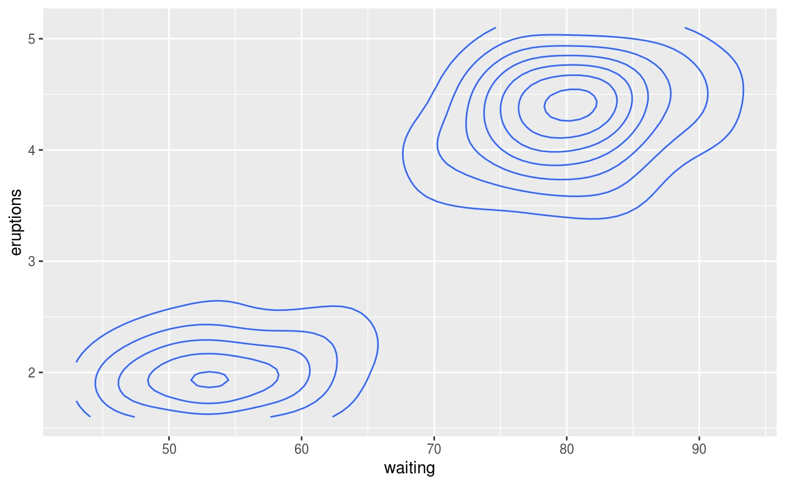
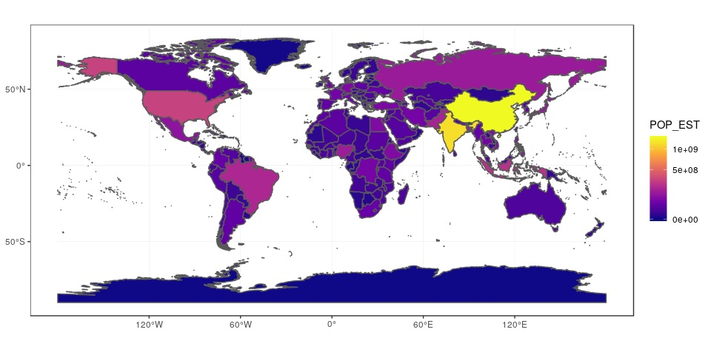
ggplot2
Grammar of graphics
Toolkit for more straightforward, easy-to-read data visualization.
Plots in base R can look nice, but typically only after great effort on the part of the programmer.
Can be used to make basic scatterplots, barcharts, and line charts, but also more complicated plots like contour plots and geospatial maps

Slide 26
Syntax of ggplot2
The command to create a plot with ggplot2 consists of 4 key elements:
  The ggplot() function.
  The data= parameter, the first argument of ggplot(), which accepts tibbles or dataframes.
  The aes(x = , y = ) function, the second argument of ggplot(), which tells the function which variables to consider.
  The geom_<shape>(), which we add to ggplot() to create the geometric shape or plot we desire corresponding to the arguments of aes(). E.g., geom_point() creates a scatterplot.
ggplot(data = , aes(x= , y= )) + geom_<shape>()

Slide 27
geoms
geoms are the visual representation of the data. We can continuously add geoms to our plot object — think of each geom as a visual layer we overlay on top of everything that precedes it.
E.g., add geom_point() for a scatterplot, geom_bar() for a barchart, and geom_line() for a line plot. There are many others.
geoms possess attributes such as color and size, which can be altered by giving each geom arguments; e.g., adding geom_point(col=‘red’) creates a scatterplot with red points.
More precisely, the aes() function creates a “mapping” from the data set to the geoms that follow the ggplot object.

Slide 28
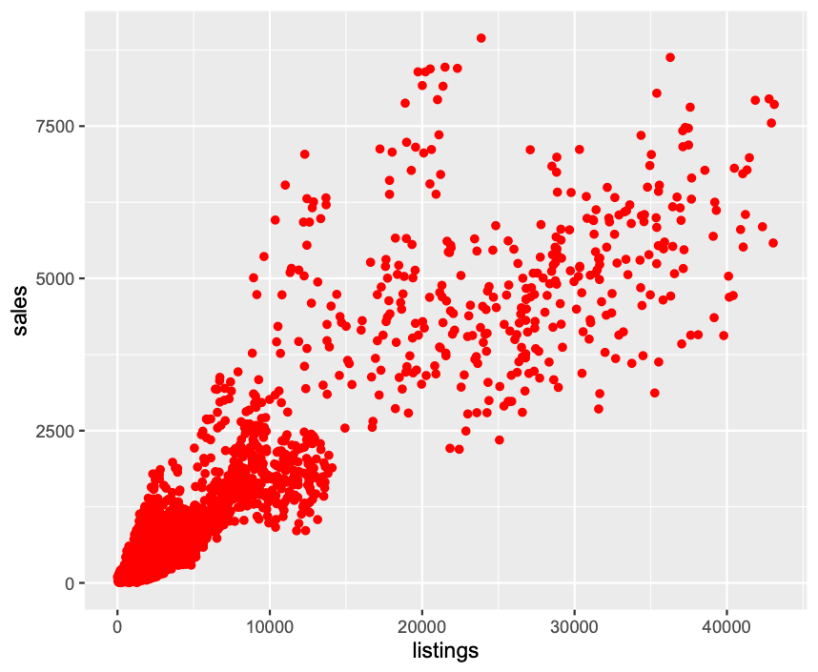

geom_point()
Basic scatterplots are created by adding geom_point() to a ggplot() object. The x= argument from aes() is plotted along the xaxis, likewise for y= and the y-axis
Can use arguments to change color and point types.
E.g., dataset txhousing (ggplot2) contains data on real estate sales in Texas. Suppose we want a scatterplot that shows the relationship between the number of listings in and the number of sales in each metropolitan area.
  list_vs_sales = ggplot(txhousing, aes(x= listings,y= sales))
  list_vs_sales + geom_point(col=‘red’)

Slide 29
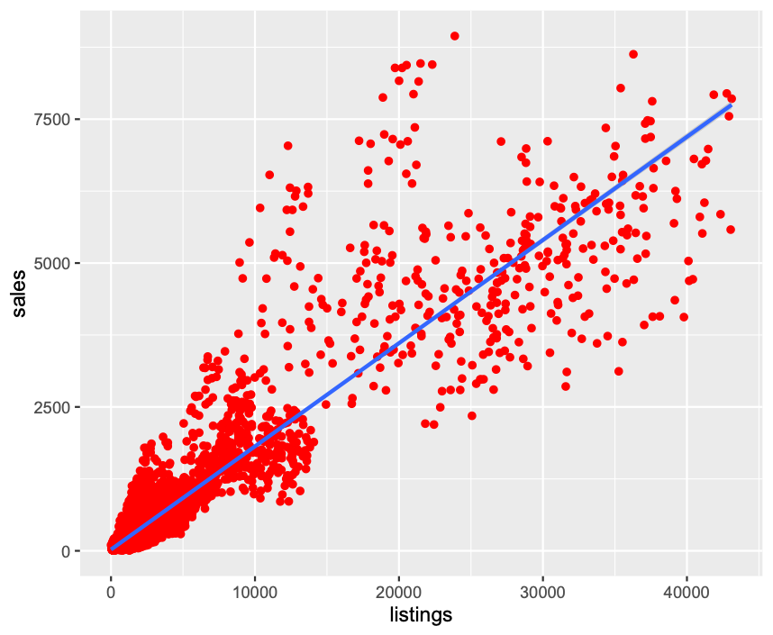
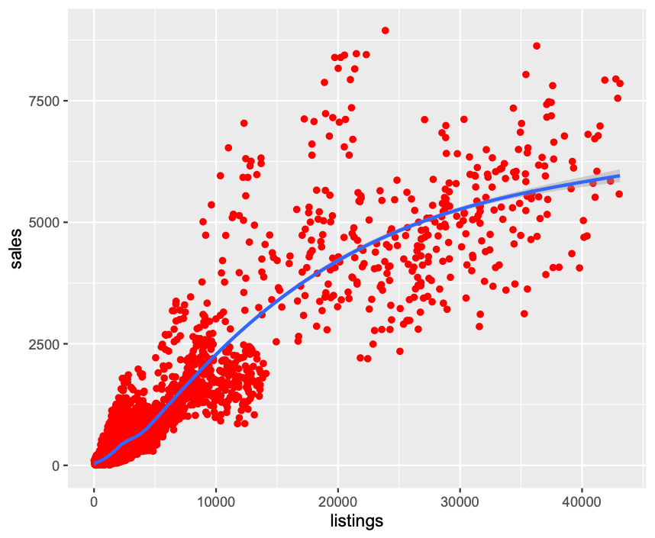
geom_point(), cont
Can add trend lines by adding the command geom_smooth(method = ).
Valid methods are linear model (‘lm’) or locally weighted scatterplot smoothing (‘loess’). Default is ‘auto’.
E.g., applied to the plot on the previous slide:
  plot_list_vs_sales = list_vs_sales + geom_point(col=‘red’)
  plot_list_vs_sales + geom_smooth(method = ‘lm’)
  plot_list_vs_sales + geom_smooth()

Slide 30
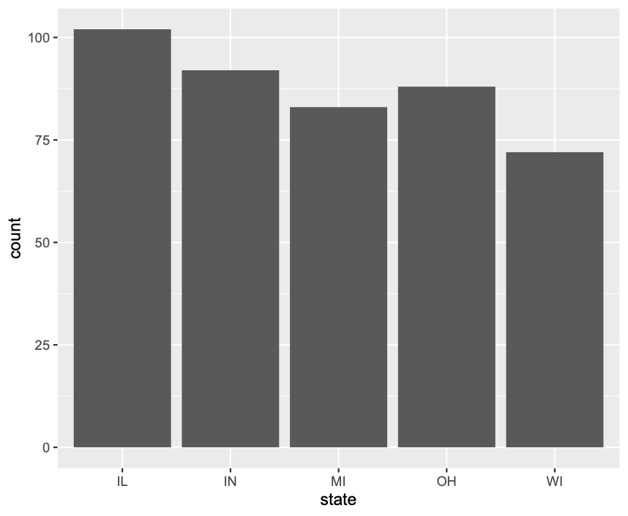
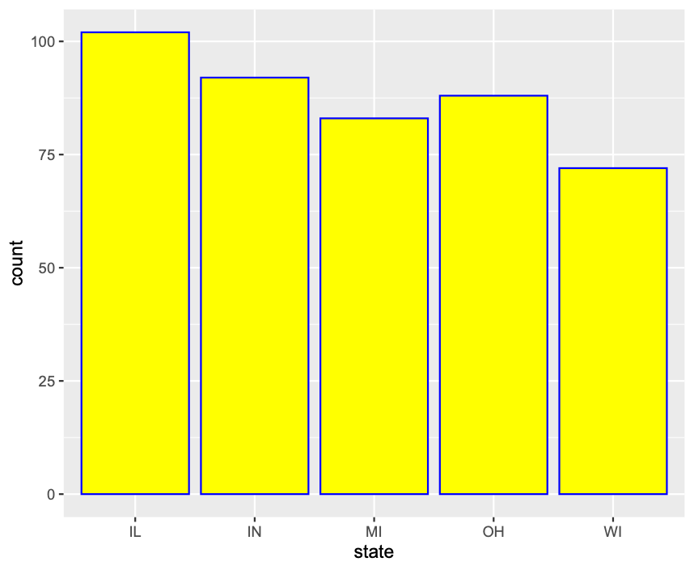
geom_bar()
Basic barcharts are created by adding geom_bar() to the ggplot object. Unlike geom_point(), this only takes the x= argument from aes(). The height of each bar is the number of times each value of x appears.
E.g., midwest (ggplot2) contains census data for every county in midwestern states. Let’s create a barplot that displays how many counties each state has:
  midwest_state = ggplot(midwest, aes(x=state))
  midwest_state + geom_bar()
  midwest_state + geom_bar(col=‘blue’, fill = ‘yellow’)

Slide 31
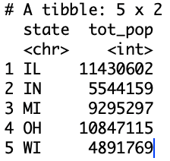
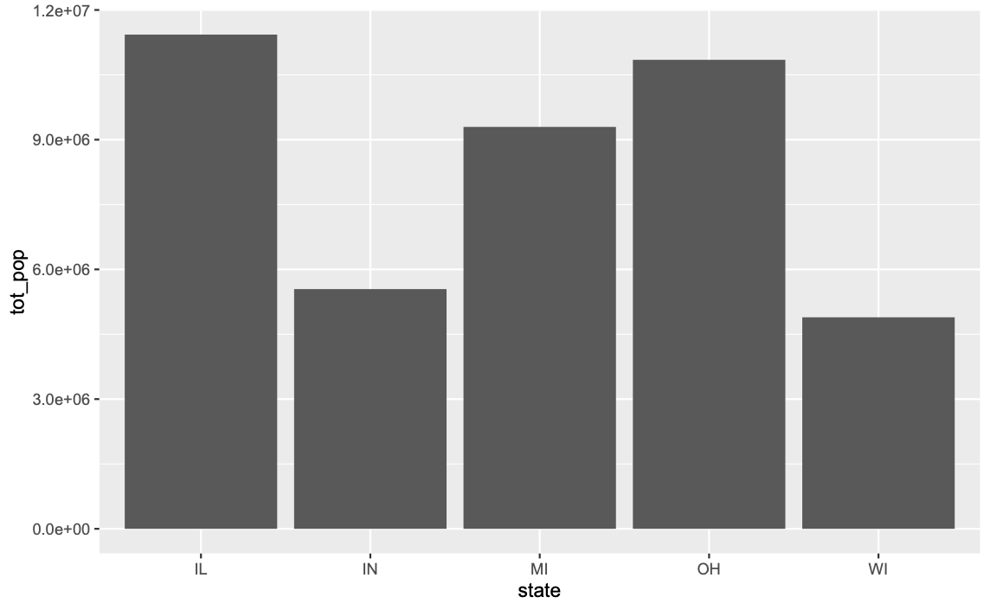
geom_bar(), cont.
The previous slide concerns creating a plot when the data are unsummarized. If the data are summarized, we use aes(class, height) and the argument stat='identity' in the geom.
E.g., create plot displaying total population of each state.
First, we need to summarize the data by creating a tibble that displays the total population of each state:
  state_pops = midwest %>% group_by(state) %>%
  summarise(tot_pop=sum(poptotal))
Now, we make the plot:
  ggplot(state_pops, aes(state,tot_pop))+
  geom_bar(stat=‘identity')
Using stat=‘identity’ forces the heights of the bars to be the y values from aes().

Slide 32
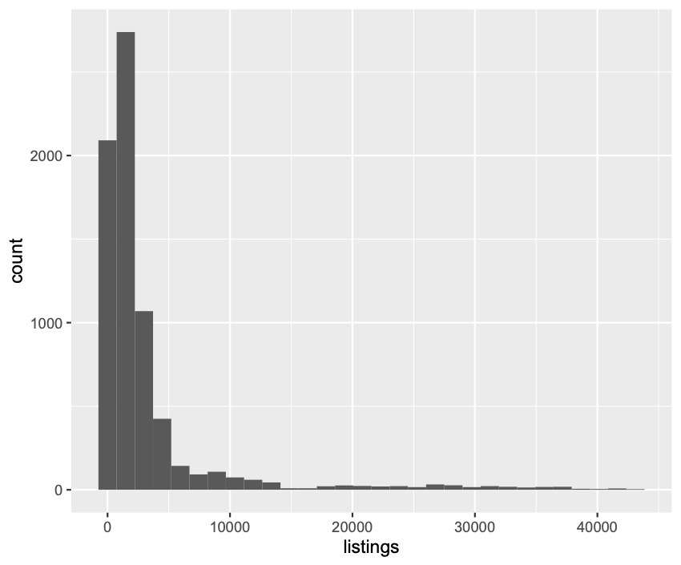
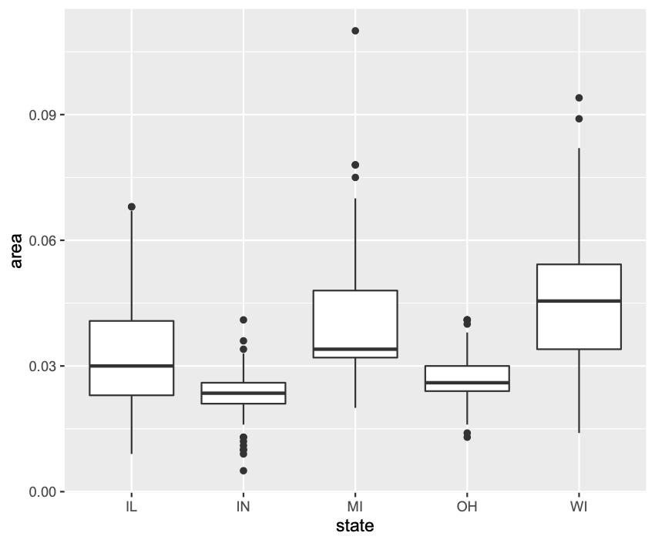
Other geoms
Histogram: Use aes(x= ) and geom_histogram(). E.g.,
  ggplot(txhousing, aes(x=listings)) + geom_histogram()
Boxplot: Use aes(class, var) and geom_boxplot(). E.g.,
  ggplot(midwest, aes(state, area)) + geom_boxplot()

Slide 33
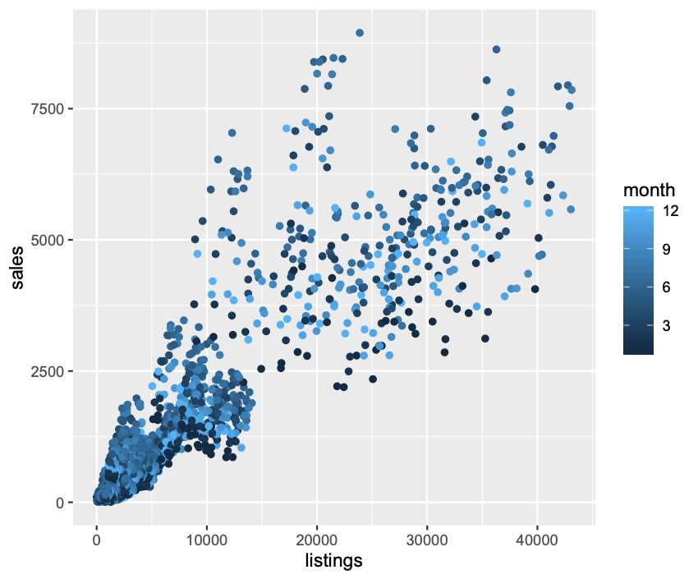
Labels and Legends
Add ggtitle(“Title”), xlab(“x-label”), and ylab(“y-label”) to the ggplot object to change the main title, x-axis label, and y-axis label of a plot.
Can change all three at once with labs(title = , x = , y = ) with each title in quotes.
Add guides() to add a legend. E.g., txhousing again; let’s add color to indicate which month each point each point belongs to, and then add a legend:
  ggplot(txhousing, aes(listings,
  sales,
  col=month)) +
  geom_point() + #color already encoded in aes()
  guides() #add default legend (gradient for numerical data)
Replace col = month with col = as.character(month) to get a traditional legend.
Add theme(legend.position = ‘left’) (or top, right, or bottom) to move the legend.

Slide 34
For more information regarding ggplot2, see the “cheat sheet” found at https://rstudio.com/wp-content/uploads/2015/03/ggplot2-cheatsheet.pdf

